Slide 1
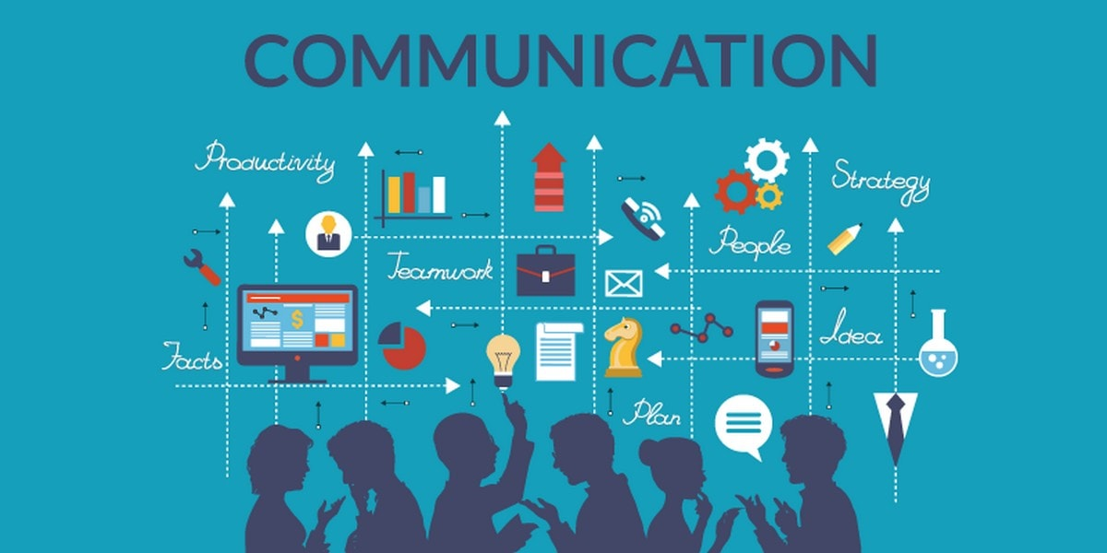
Communication Skills
Holiday Homework
By:- Aniket Dixit Class IX-A
Notes:
Greetings Everyone!
My name is Aniket Dixit, and I am from class 9th A.
So, today’s topic is “Communication Skills”.
In this chapter, I will be telling you-
1- What is Communication
2- Barriers of communication
3- Different types of Communications and their Advantages and Disadvantages
So, lets start!

Slide 2

What is Communication?
Communication is simply the act of transferring information from one place, person or group to another.
Notes:
What is Communication?
(!Read the para)
So, as we have read, Communication basically means “Sharing of Information” b/w two people, places or groups.

Slide 3
Barriers In Communication
Semantic Barriers means confusion created due to the words used by the sender and the interpreted meaning of those words by the receiver.
Emotional Barriers can hamper communication. If the sender is angry or the receiver is upset, the message can be conveyed wrongly.
Gender Barriers:- ASSUMPTION of how men and women communicate often affect our understanding of messages.
Visual Perception relates to our ability to make sense of we see and hear.
Environmental Barriers like noise or disturbance hampers communication.
Personal Factors like lack of confidence or habits affect communication.
Cultural Barriers occur when we are unaware about the norms followed in various cultures.
Notes:
(!Read the Para)

Slide 4
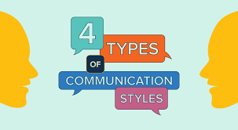
Types of communication
There are four types of communication, they are:-
Verbal Communication
Non-Verbal Communication
Visualizations
Written Communication
Notes:
(!Read the para)

Slide 5
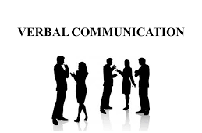
Verbal Communication
Verbal communication is the use of sounds and words to express yourself. An example of verbal communication is saying “No” when someone asks you to do something you don't want to do.
Notes:
(!Read the para)
This basically means that the sender is speaking, and the receiver is listening and they both are sharing information.

Slide 6

Advantages and disadvantages of Verbal communication
Advantages:-
First of all, it’s convenient
Easy to prepare
It saves your Money and time
Message will have clarity
Disadvantages:-
Chances that receiver won’t be able to understand what you say
It is not convenient for long messages
Irrelevant Information
You can also crate a misunderstanding
Notes:
(!Read the para)

Slide 7

Non-Verbal communication
Non-verbal communication refers to gestures, facial expressions, tone of voice, eye contact, body language, posture, and other ways people can communicate without using language.
Notes:
(!Read the para)
It basically means that the sender and receiver are exchanging by using gestures, body language and facial expressions.

Slide 8
Advantages and Disadvantages of Non-Verbal communication
Advantages:-
It is easy to present
It can substitute a verbal language
It is quicker and reduces waste of time
Disadvantages:-
Conveying of long messages is difficult
There are high chances of misunderstanding
Notes:
(!Read the para)

Slide 9

Visualizations
By definition, visualizations is the practice of graphically representing information to efficiently, effectively create meaning. There are many types of content in the realm of visualizations, with examples including infographics, interactive content, motion graphics, and more.
Notes:
(!Read the para)
This means to show videos and photos to grab the attention of the receiver.

Slide 10
Advantages and Disadvantages of Visualizations
Advantages:-
Gets the attention of the participants
Easy to follow
Simple Presentation
Easier to remember
Disadvantages:-
Costly
Learner experiences difficulty
It is easier to loose focus
Requires well designed material
Notes:
(!Read the para)

Slide 11
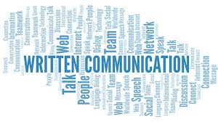
Written Communication
Written Communication means the sending of messages, orders or instructions in writing through letters, circulars, manuals, reports, bulletins, etc. It is a formal method of communication and is less flexible.
Notes:
(!Read the para)
This means that the communication is happening in writing b/w the sender and the receiver.
For e.g.- In schools, if the school staff wants to tell something to their students, they write a notice and put it on the School Notice Board.

Slide 12
Advantages and Disadvantages of written communication
Advantages:-
It is a permanent record, ideal for official and legal matters
Presents complicated matter accurately
It can be referred to any time for clarification
Disadvantages:-
It is time consuming
It is costly as it uses paper and printing
It causes delay in taking decisions
Notes:
(!Read the para)

Slide 13

This Photo by Unknown Author is licensed under CC BY-SA

